Slide 1


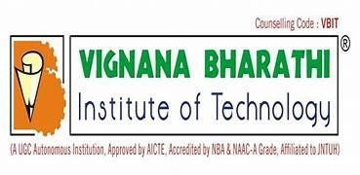
MAJOR PROJECT IMPLEMENTATION REVIEW ON
IOT-BASED AUTOMATED GRAIN DRYING AND RAIN PROTECTION SYSTEM USING TELEGRAM ALERTS
--TEAM MEMBERS—
M. KEERTHANA 22P61A1271
P. RUCHITH 22P61A1289
T. NAGASRI 22P61A12B5
P. RAGHURAM 22P61A1288
PROJECT GUIDE: MRS. N. INDIRA PRIYADARSHINI

Slide 2
AGENDA
▶ OBJECTIVE
▶ ABSTRACT
▶ LITERATURE REVIEW
▶ EXISTING SYSTEM
▶ PROPOSED SYSTEM
▶ ARCHITECTURE
▶ SOFTWARE REQUIREMENTS
▶ HARDWARE REQUIREMENTS
▶ OUTPUTS
▶ CONCLUSION
▶ REFERENCES

Slide 3
OBJECTIVE
▶ Develop a blockchain-enabled decentralized trust management and secure usage control system for IoT big data (BlockBDM).
▶ Ensure tamper-resistant storage of IoT data.
▶ Provide secure usage and controlled access to the data.
▶ Introduce an incentive mechanism for content sharing using blockchain tokens.
▶ Use a permissioned blockchain for trust evaluation and access control.
▶ Use public blockchain tokens for rewarding data contribution and consumption.
▶ Improve data integrity, privacy, and controlled access in IoT big data systems.

Slide 4
ABSTRACT
▶ The project focuses on making IoT devices more secure and trustworthy using blockchain technology.
▶ IoT devices, such as sensors, often send important data, but they can be hacked or send false information.
▶ To address this issue, each IoT device is assigned a trust score based on its behavior.
▶ The trust score is stored on the blockchain so that it cannot be altered or faked.
▶ A website dashboard is provided for administrators to view trust scores and monitor device activity.
▶ The system improves IoT security, ensures transparency, and increases reliability for real-world applications.

Slide 5
LITERATURE REVIEW
Aloysius, A., & Arulkumar, V. (2025), “Advancing IoT Security through Blockchain-Driven Dynamic Trust Evaluation,” Indian Journal of Science and Technology, vol. 18, no. 25, pp. 1–9, 2025.
Summary: Proposed a blockchain-based Dynamic Trust Evaluation Framework for IoT using Attribute-Based Access Control (ABAC) and Elliptic Curve Digital Signature Algorithm (ECDSA). The framework achieved 95.2% accuracy in detecting attacks. Limitations: Scalability and energy efficiency under real-world IoT conditions remain untested.
Almarri, S., & Aljughaiman, A. (2025), “Blockchain Technology for IoT Security and Trust,” Journal of Emerging Technologies, vol. 12, no. 4, pp. 44–53, 2025.
Summary: Reviewed blockchain’s role in IoT trust and sustainability, highlighting benefits in smart grids and supply chains.
Limitations: Lacks real-world validation and integration strategies for legacy IoT systems.

Slide 6
LITERATURE REVIEW
Zhaofeng, M., Lingyun, W., Xiaochang, W., Zhen, W., & Weizhe, Z. (2025), “Blockchain-Enabled Decentralized Trust Management and Secure Usage Control of IoT Big Data,” IEEE Internet of Things Journal, vol. 12, no. 2, pp. 1120–1133, 2025.
Summary: Proposed a blockchain-based decentralized trust framework for IoT big data to improve transparency and secure usage control.
Limitations: Introduces computational overhead and may struggle with large-scale IoT performance.
Qian, Q., et al. (2025), “A Multi-layer Information Dispersal Based Encryption Algorithm for Client-Side Security in Cloud Storage,” Future Generation Computer Systems, vol. 148, pp. 233–242, 2025.
Summary: Introduced a multi-layer information dispersal encryption method to secure IoT cloud storage and protect client-side data.
Limitations: Focused mainly on storage security; does not provide decentralized IoT trust management.

Slide 7
LITERATURE REVIEW
5. Zhou, P., et al. (2025), “Differentially-private and Trustworthy Online Social Multimedia Big Data Retrieval,” IEEE Transactions on Multimedia, vol. 27, no. 5, pp. 989–1003, 2025.
Summary: Developed a differentially-private data retrieval framework with trust evaluation for online social multimedia systems.
Limitations: Domain-specific to multimedia retrieval; not adaptable to heterogeneous IoT environments.

Slide 8
Existing System
▶ In the Existing IoT trust management systems, all devices are controlled by a centralized server. This server is responsible for giving trust values to devices and deciding which devices can share or access data. But this centralized approach has many problems:
Single Point of Failure – If the server goes down or is hacked, the whole system stops working.
Data Tampering – Since all trust values are stored in one place, an attacker or insider can easily change them without being noticed.
Static Trust Scores – Device trust levels do not update dynamically with behavior; once a device is marked trusted, it stays trusted even if it later misbehaves.
Lack of Transparency – Users and administrators cannot verify how trust scores are calculated or updated.

Slide 9
Proposed System
▶ The system is designed to overcome the problems of centralized IoT trust systems.
▶ Each IoT device is given a trust score based on its behavior.
▶ Trust scores are stored on the blockchain, making them tamper-proof and transparent.
▶ Smart contracts automatically decide which devices can share or access data.
▶ Trust scores are updated dynamically and cannot be modified by attackers.
▶ The system ensures improved security, transparency, and reliability for IoT networks.
▶ A web dashboard is provided for administrators to view device trust levels, logs, and activity in real time.

Slide 10
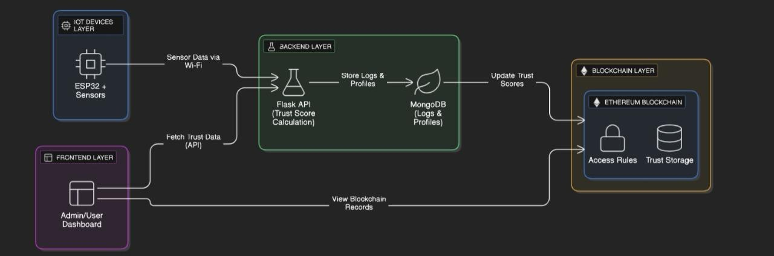
Architecture Diagram

Slide 11
Technologies used
Software Requirements:
▶ Frontend: React.js
▶ Backend: Python with Flask
▶ Blockchain Platform: Ethereum
▶ Blockchain Integration: Web3.py
▶ Database: MongoDB

Slide 12
Technologies used
Hardware Requirements:
▶ Processor: RAM: (Minimum 8 GB)
▶ Hard Disk: At least 256 GB
▶ IoT Device:ESP32 (with DHT11/DHT22 sensor)

Slide 13
OUTPUTS
Home Page
IOT Device
Blockchain Records
Final Output

Slide 14
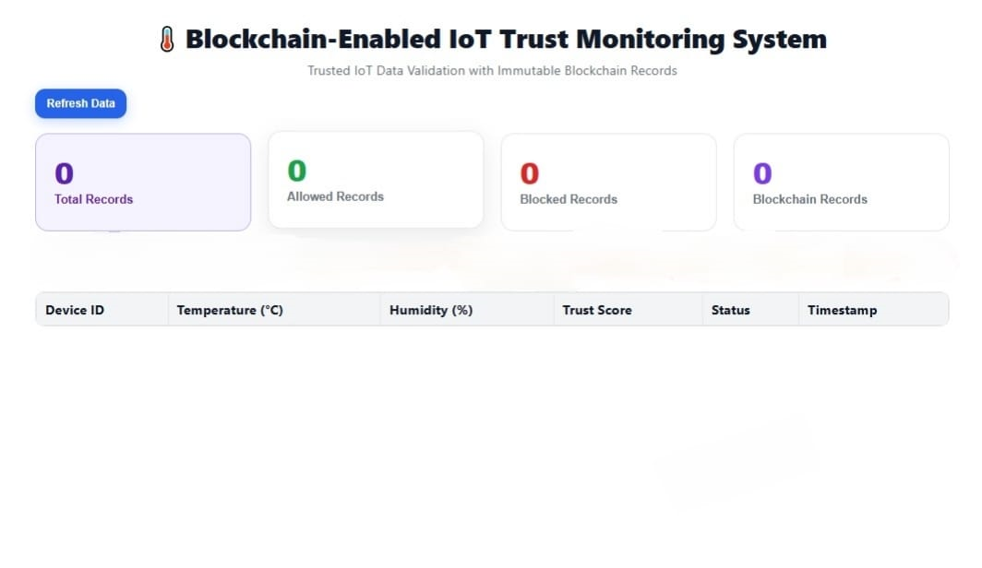
HOME PAGE

Slide 15
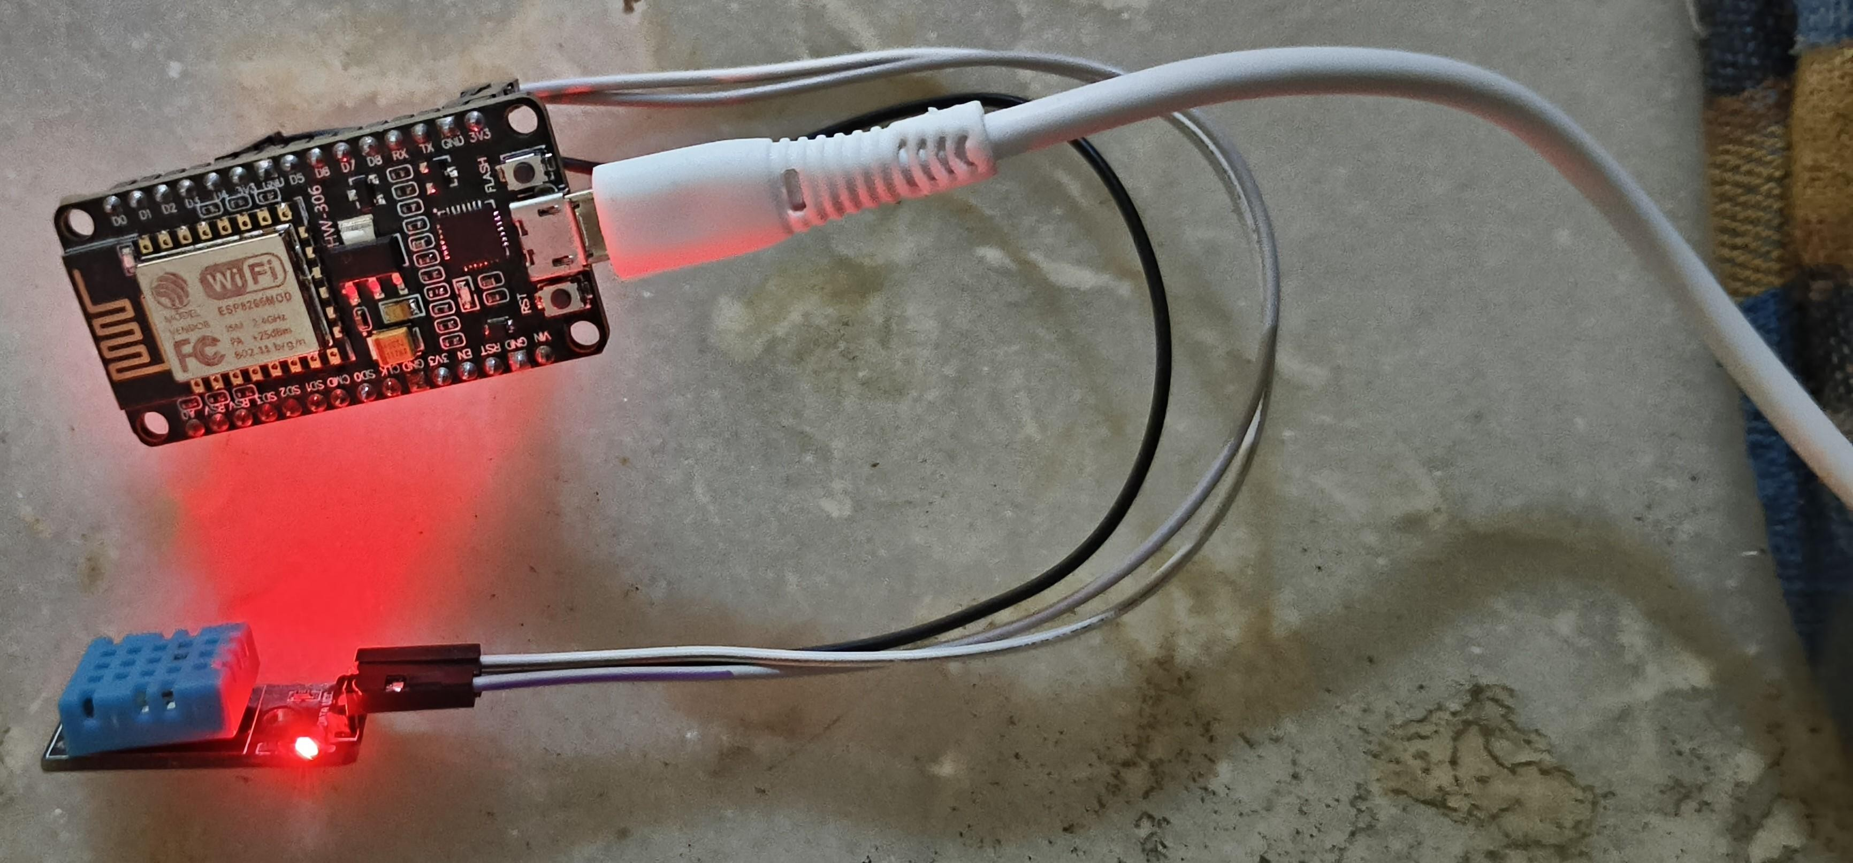
IOT DEVICE

Slide 16
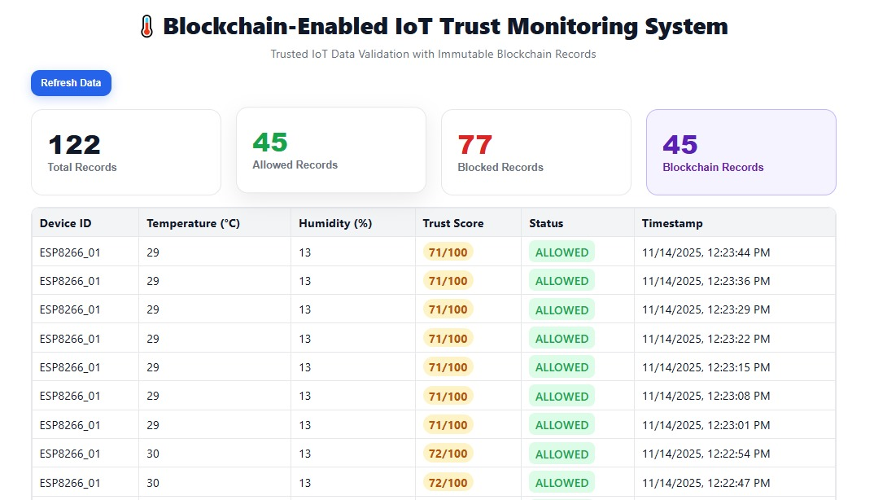
Blockchain Records

Slide 17
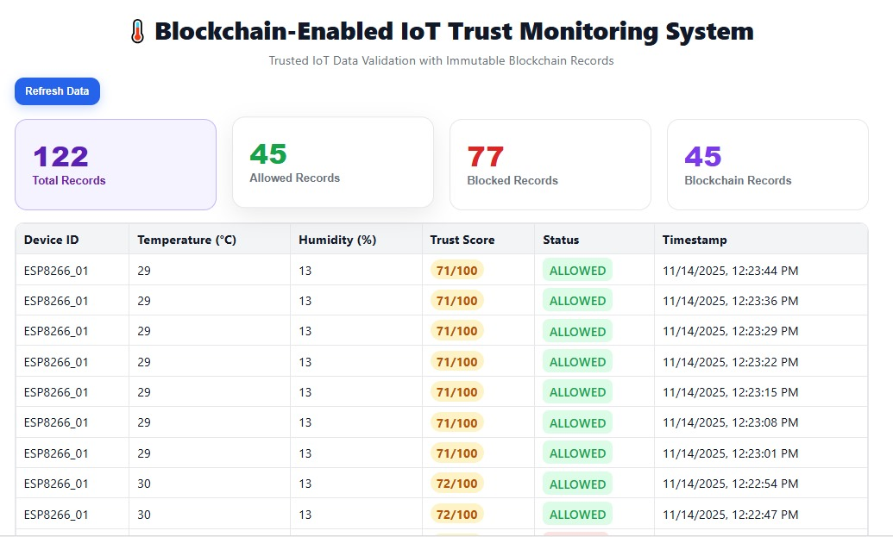
FINAL OUTPUT

Slide 18
Conclusion
▶ The blockchain-based system offers a secure and transparent method to manage IoT device trust and control data access.
▶ Trust scores are stored on an immutable blockchain, preventing tampering and ensuring reliability.
▶ Smart contracts automatically enforce access policies, removing risks like data manipulation and single points of failure.
▶ The system allows dynamic trust updates and provides transparent auditing.
▶ Only reliable devices are permitted to share or access data.
▶ This approach is suitable for applications in smart cities, agriculture, healthcare, and industrial IoT.

Slide 19
References
[1]. A.Aloysius and V. Arulkumar, “Advancing IoT Security through Blockchain-Driven Dynamic Trust Evaluation,” Indian Journal of Science and Technology, vol. 18, no. 25, pp. 1–9, 2025.
[2]. S.Almarri and A. Aljughaiman, “Blockchain Technology for IoT Security and Trust,” Journal of Emerging Technologies, vol. 12, no. 4, pp. 44–53, 2025.
[3]. M.Zhaofeng, W. Lingyun, W. Xiaochang, W. Zhen, and Z. Weizhe, “Blockchain- Enabled Decentralized Trust Management and Secure Usage Control of IoT Big Data,” IEEE Internet of Things Journal, vol. 12, no. 2, pp. 1120–1133, 2025.
[4]. Q.Qian, et al., “A Multi-layer Information Dispersal Based Encryption Algorithm for Client-Side Security in Cloud Storage,” Future Generation Computer Systems, vol. 148, pp. 233–242, 2025.

Slide 20
References
[5]. P. Zhou, et al., “Differentially-private and Trustworthy Online Social Multimedia Big Data Retrieval,” IEEE Transactions on Multimedia, vol. 27, no. 5, pp. 989–1003, 2025.
[6]. J.-S. Fu, et al., “Secure Data Storage and Searching for Industrial IoT Using Fog and Cloud Computing,” IEEE Transactions on Industrial Informatics, vol. 20, no. 1, pp. 211–222, 2024.
[7]. Y. Zhao, L. T. Yang, and J. Sun, “Privacy-Preserving Tensor-Based Multiple Clusterings on Cloud for Industrial IoT,” IEEE Transactions on Industrial Informatics, vol. 15, no. 4, pp. 2372–2381, Apr. 2023.

Slide 21
References
[8].Ma, Z., Jiang, M., Gao, H., Wang, Z, Blockchain for Digital Rights Management. Future Generation Computer Systems, 89, 746–764 (2023).
[9].Gai, K., Choo, K.-K.R., Zhu, L. Blockchain-Enabled Reengineering of Cloud Datacenters. IEEE Transactions on Cloud Computing, 5(2), 1–10 (2022).
[10].Santosh Reddy Addula & Aitizaz Ali,.A Novel Permissioned Blockchain Approach for Scalable and Privacy-Preserving IoT Authentication. Journal of Cyber Security and Risk Auditing, 2022(4), pp. 222-237.

Slide 22


